Slide 1
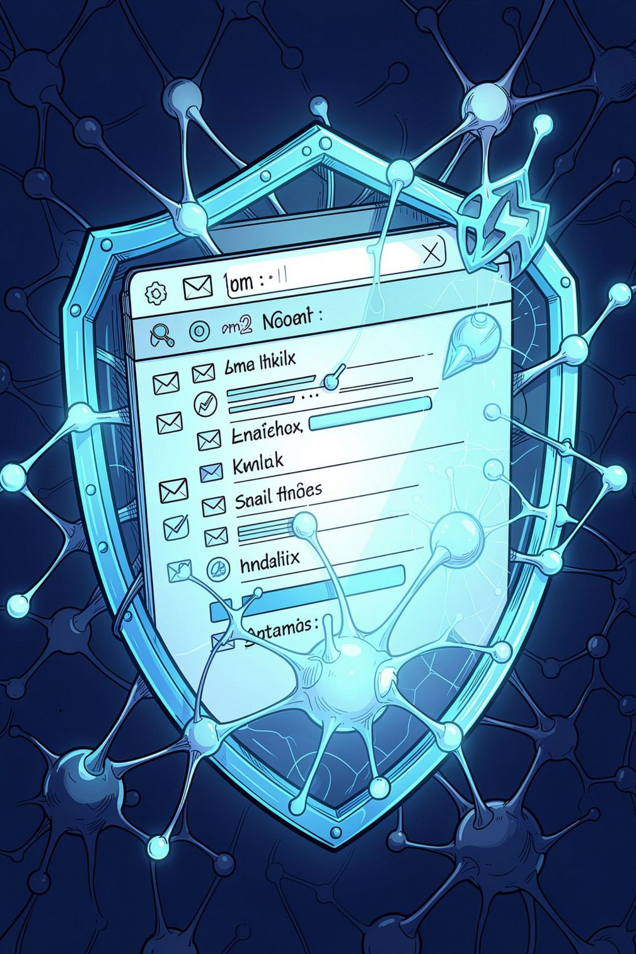
ML-Based Email Spam Detection & Intelligent Classification
An intelligent system leveraging Machine Learning and NLP to automatically classify emails, detect phishing threats, and continuously improve detection accuracy — securing communication at enterprise scale.
MACHINE LEARNING
NLP
CYBERSECURITY
G.KUMARI
323129510013

Slide 2
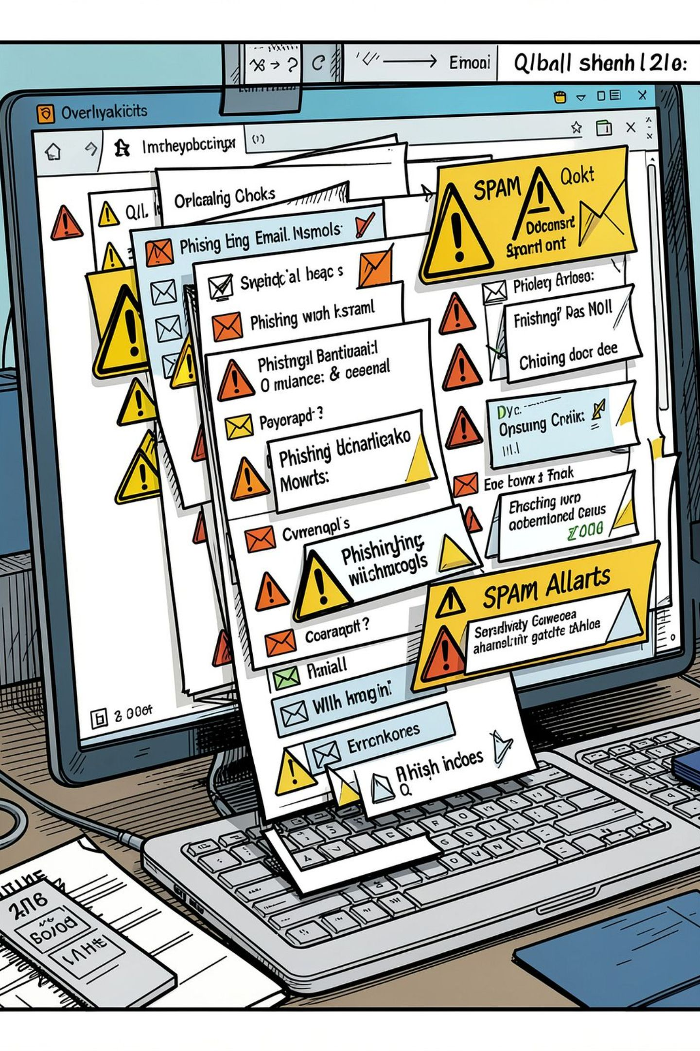
The Growing Email Threat Landscape
Volume Overload
Over 333 billion emails sent daily — making manual filtering impossible and rule-based systems inadequate.
Evolving Threats
Spammers constantly adapt tactics, bypassing static filters with obfuscated content and social engineering.
Phishing & Malware
Malicious links, credential theft, and ransomware payloads embedded in seemingly legitimate emails.
False Positives
Traditional systems misclassify legitimate emails, disrupting business communication and eroding trust.

Slide 3
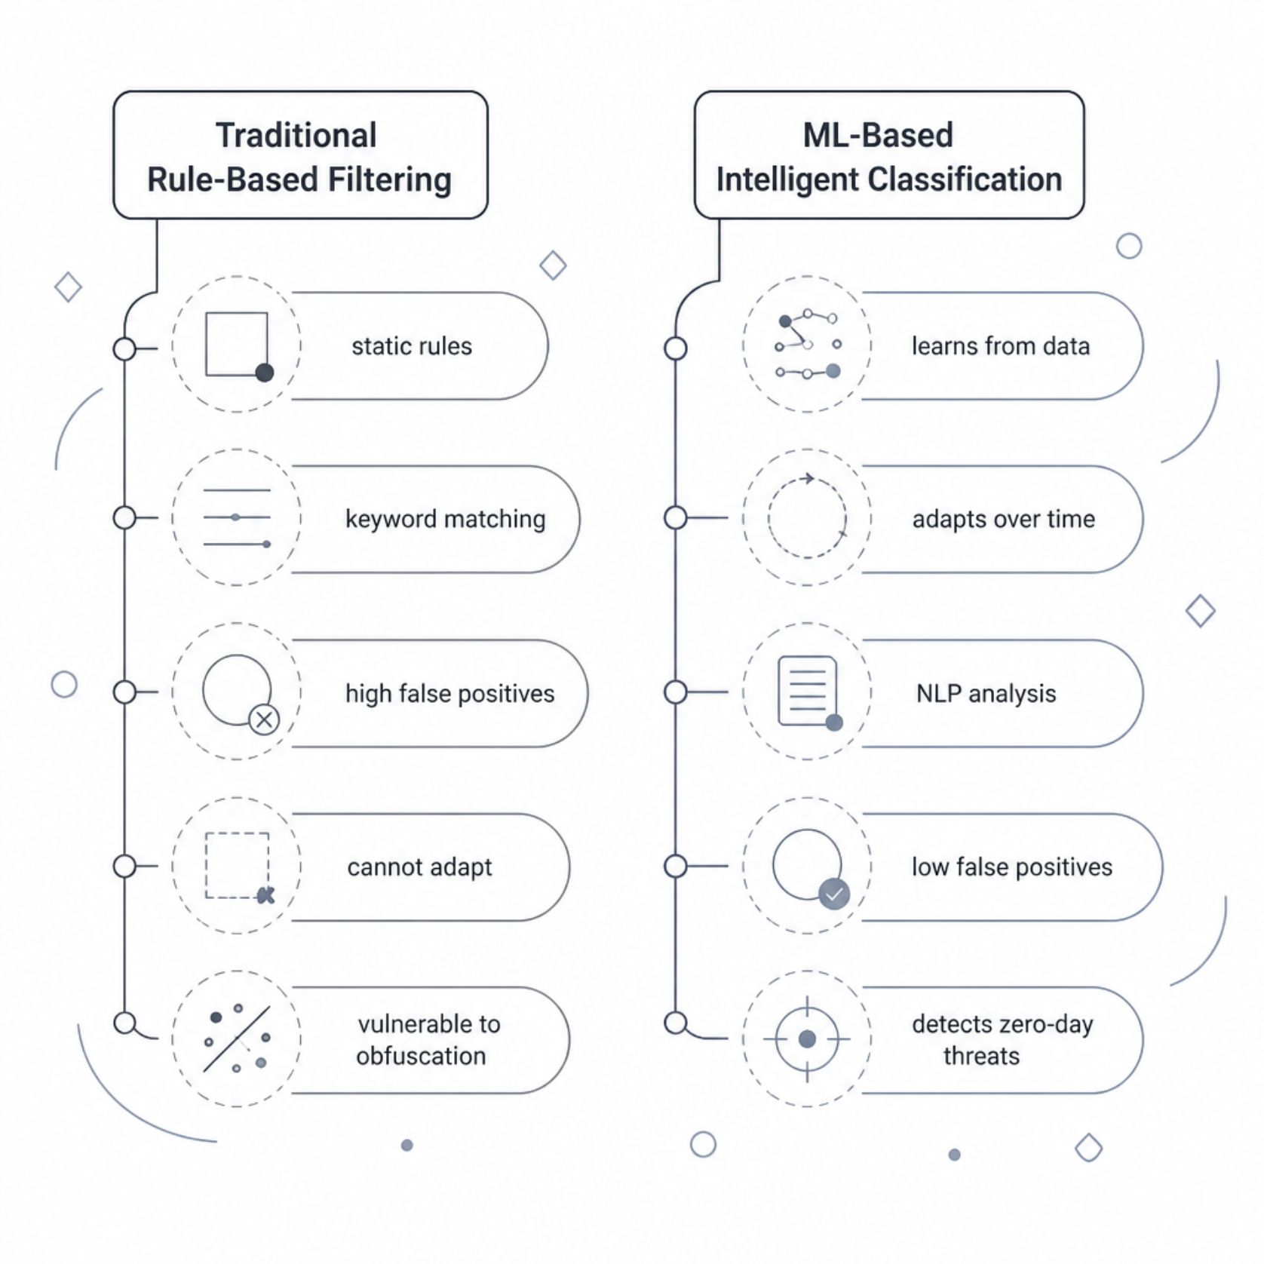

Limitations of Existing Systems
Why Rule-Based Filters Fall Short
Static keyword blacklists cannot detect novel attack patterns
No contextual understanding of email content or intent
High maintenance — rules must be manually updated constantly
Cannot analyze sender reputation, metadata, or attachment behaviour holistically
Zero adaptability to emerging phishing techniques
Organisations relying solely on rule-based filters experience up to 30% higher false-positive rates compared to ML-driven systems.

Slide 4

Proposed System & Objectives
An end-to-end intelligent email security platform combining NLP, supervised ML, and real-time classification to protect users from spam, phishing, and malicious content.
1
2
Automated Classification
Continuous Learning
Classify incoming emails as Spam, Phishing, or Legitimate in real time with high accuracy.
Retrain models on new data to adapt to evolving threat patterns without manual intervention.
3
4
Phishing Detection
Analytics Dashboard
Analyse URLs, sender domains, and content semantics to identify sophisticated phishing attempts.
Provide administrators with real-time threat reports, classification metrics, and trend visualisation.

Slide 5

System Architecture & Email Processing Workflow
Email Ingestion
Classification
Preprocessing
The pipeline processes each email through six sequential stages — from raw ingestion through intelligent classification — delivering a verdict in under 500ms for real-time protection.
User Roles
Non-Functional Requirements
End User: View classified inbox, report false positives/negatives, manage preferences
Administrator: Configure policies, monitor dashboards, manage model retraining, audit logs
Classification latency under 500ms per email
99.9% system availability with horizontal scalability
End-to-end encryption for email data in transit and at rest
GDPR-compliant data handling and audit trails

Slide 6
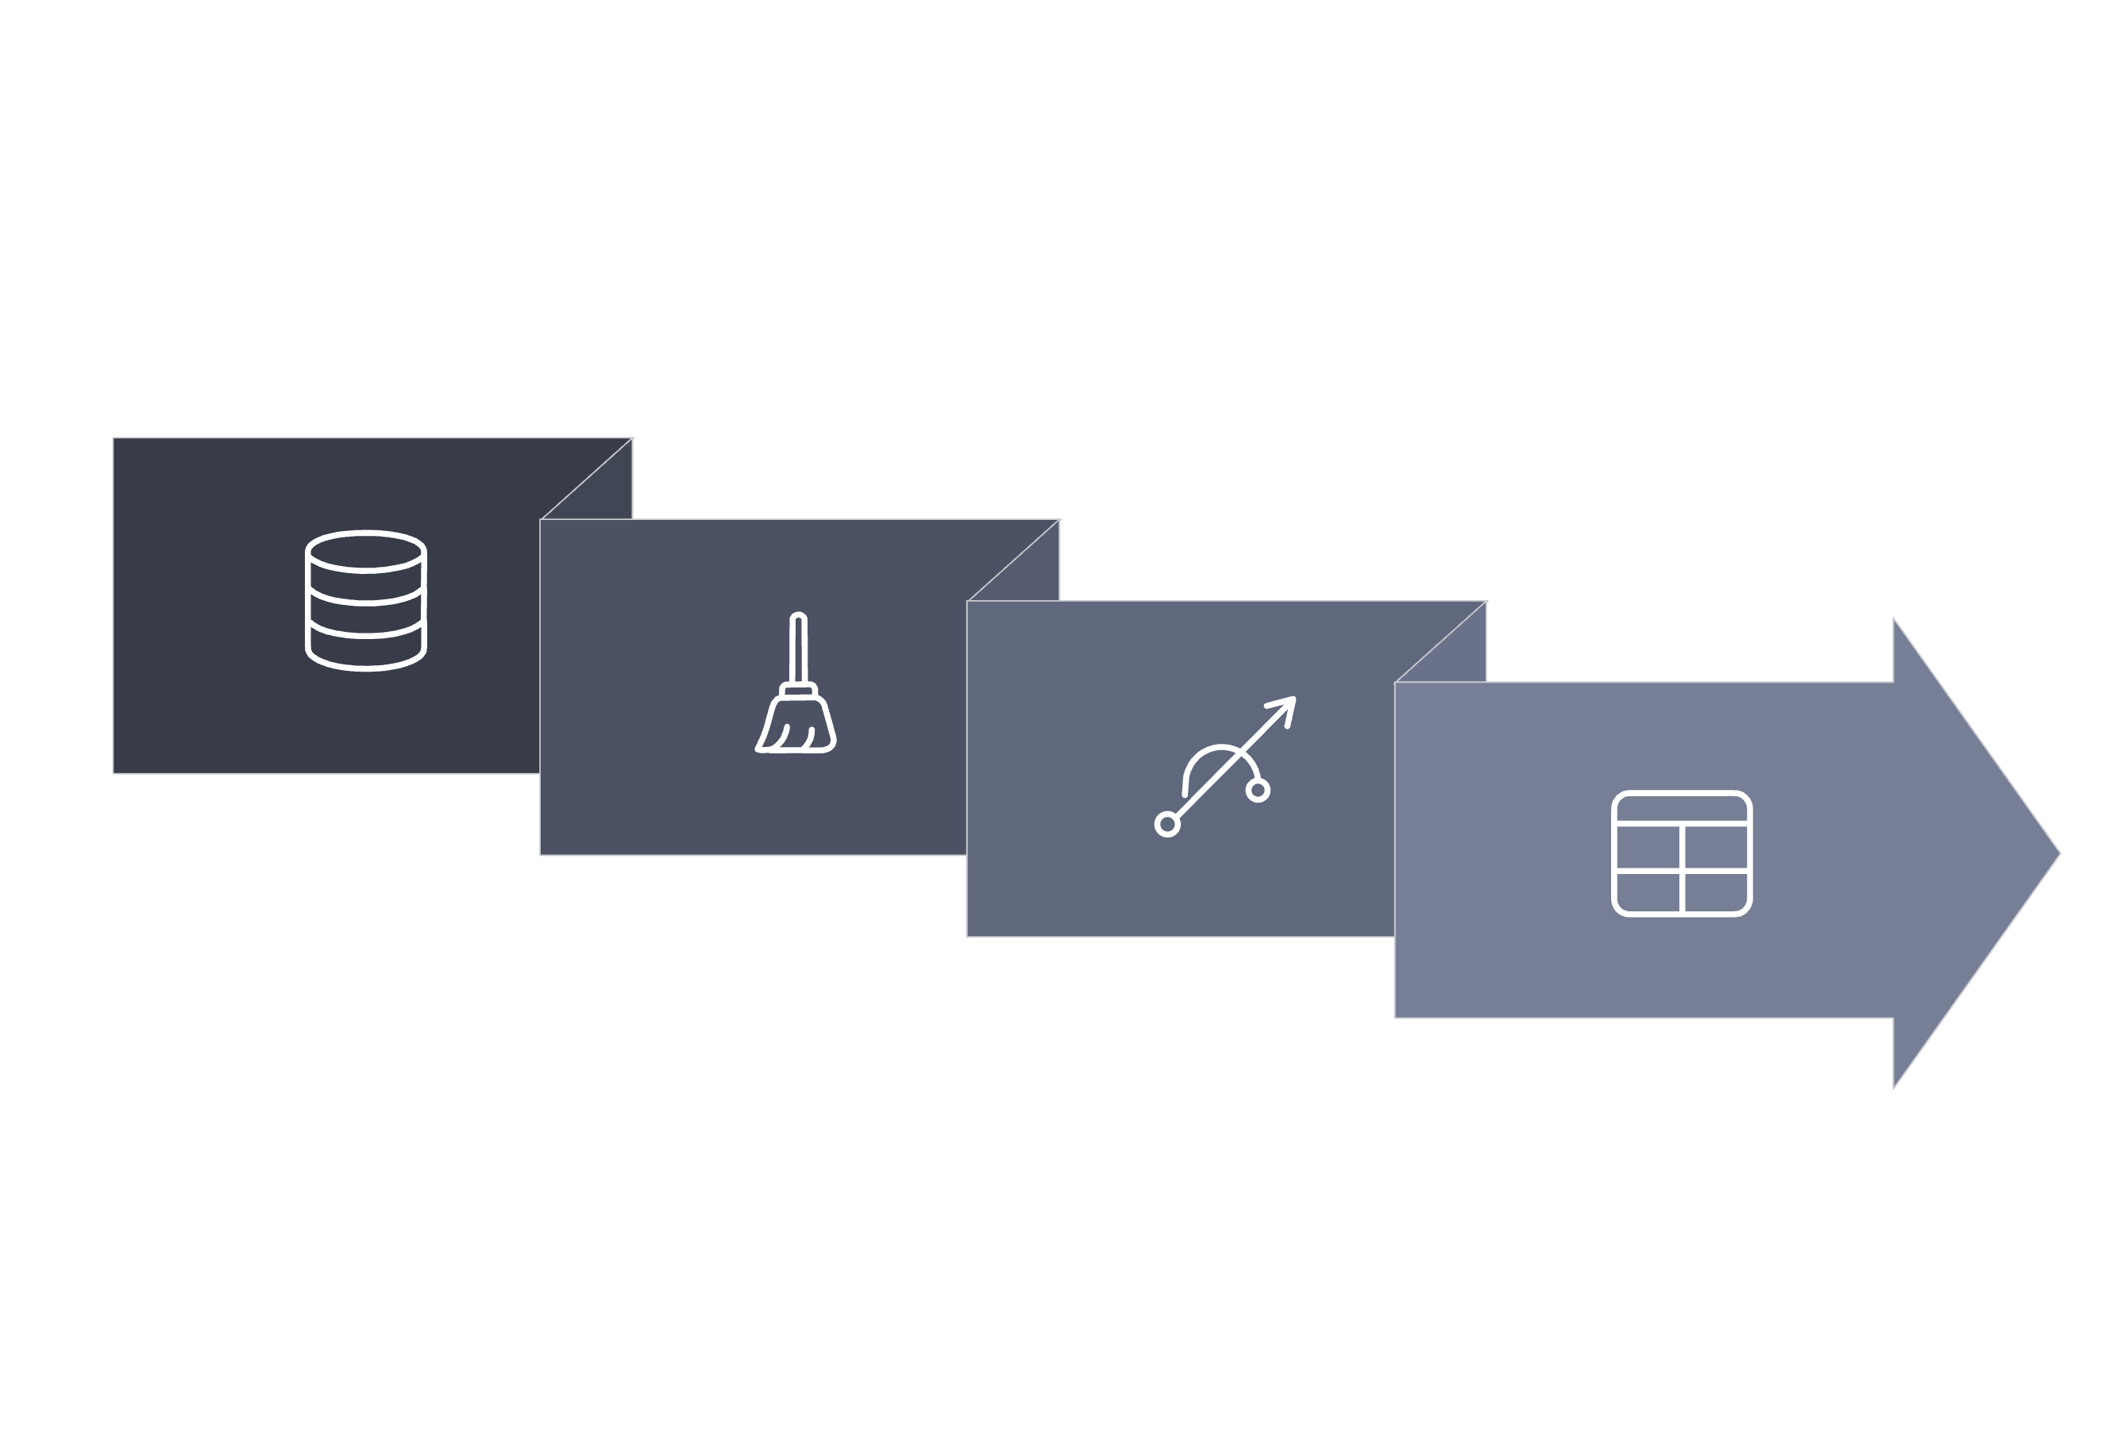
Data Pipeline: Collection, Preprocessing & Feature Extraction
Preprocessing
Model Input
Data Collection
Feature Extraction
Raw email data flows through four stages — collection, cleaning, feature extraction, and model input — producing a structured feature matrix for classification.
NLP Techniques Applied
Key Feature Categories
Tokenisation & Lemmatisation — normalise text for consistent feature representation
TF-IDF Vectorisation — weigh term importance across the email corpus
Named Entity Recognition — detect suspicious sender names and domains
Sentiment & Urgency Analysis — flag emotionally manipulative phishing language
Content Features: Word frequency, special character ratio, link density
Header Features: SPF/DKIM status, reply-to mismatch, hop count
URL Features: Domain age, HTTPS presence, URL length, entropy
Behavioural Features: Sending frequency, recipient count, time-of-day patterns

Slide 7
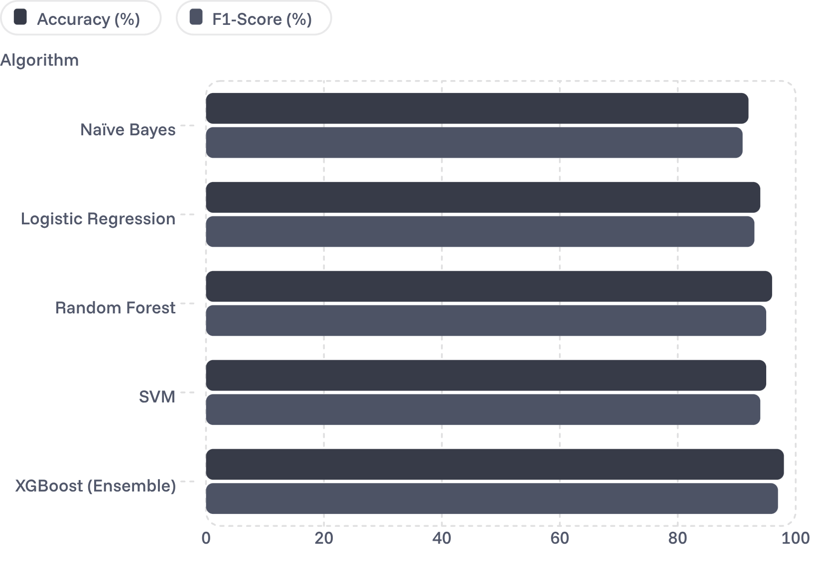

Machine Learning Algorithms & Model Training
Training Methodology
Dataset: Enron Spam Corpus + Ling-Spam + custom labelled data (500K+ emails)
Split: 80% training, 10% validation, 10% test — stratified sampling
Techniques: Cross-validation, SMOTE for class imbalance, grid search for hyperparameters
Retraining: Scheduled weekly retraining + on-demand trigger from user feedback
XGBoost Ensemble achieved the highest F1-Score (97%), selected as the primary classifier for production deployment.

Slide 8
Performance Evaluation & Classification Results
98%
97%
Accuracy
Precision
Overall correct classification rate on held-out test data
Of emails flagged as spam, 97% were truly malicious
96%
97%
Recall
F1-Score
96% of actual spam emails were successfully detected
Harmonic mean of precision and recall — balanced performance
Spam vs. Phishing Detection
Continuous Improvement Loop
Spam Detection: Bulk unsolicited content identified via TF-IDF + Bayesian scoring
Phishing Detection: URL analysis, domain spoofing checks, and NLP urgency detection
False Positive Rate: Below 2% — minimal disruption to legitimate communication
User feedback (report spam / not spam) feeds directly into retraining pipeline
Drift detection monitors performance degradation and triggers auto-retraining
A/B testing validates new model versions before production rollout

Slide 9
Technology Stack, Security & Modules
Technology Stack
Security Features
Backend: Python, Flask/Django REST API, Celery (async tasks)
ML/NLP: Scikit-learn, XGBoost, SpaCy, NLTK, Hugging Face Transformers
Database: PostgreSQL (structured data), Redis (caching), Elasticsearch (search)
Frontend: React.js, Chart.js, D3.js (analytics dashboard)
Infrastructure: Docker, Kubernetes, AWS/GCP, Nginx
TLS 1.3 encryption for all data in transit
AES-256 encryption for stored email metadata
Role-based access control (RBAC) for admin and user modules
SPF, DKIM, DMARC verification at ingestion layer
Immutable audit logs for compliance (GDPR, HIPAA)
Core System Modules
User Module
Admin Module
Inbox management, classification view, feedback submission, preference settings
Policy configuration, user management, model retraining triggers, system monitoring
ML Module
Analytics Module
Model training, inference engine, drift detection, version management
Threat dashboards, performance reports, trend visualisation, export capabilities

Slide 10



Advantages, Applications & Future Roadmap
Key Advantages
Real-time threat detection with sub-second latency
Adaptive learning reduces manual rule maintenance
Scalable architecture supporting millions of emails/day
Data-driven decisions via comprehensive analytics
Target Applications
Enterprise email gateways and corporate IT security
Cloud email providers (Gmail, Outlook integrations)
Government and financial institution communication systems
Educational institutions and healthcare portals
Future Enhancements
Deep learning with BERT-based transformer models
Federated learning for privacy-preserving model training
Integration with SIEM platforms for unified threat intelligence
Explainable AI (XAI) for transparent classification decisions
Expected Outcome: A production-ready, ML-powered email security system achieving 98% classification accuracy, reducing phishing incidents by over 85%, and providing a scalable foundation for enterprise-grade communication security.

